Slide 1


Reconfiguration of Linear Surface Chemical Reaction Networks with Bounded State Change
1 Burnout System
Species:
Rules:
$$→$$
$$→$$
Configuration I
Authors: Robert M. Alaniz, Michael Coulombe, Erik D. Demaine, Bin Fu, Timothy Gomez, Elise Grizzell, Ryan Knobel, Andrew Rodriguez, Robert Schweller, Tim Wylie

Slide 2
Overview
Introduction to the Model
Motivation
Previous work/Contributions
  Linear Surfaces
  General Surfaces
  Grid Surfaces
Conclusion

Slide 3
Introduction to the Model

Slide 4
Chemical Reaction Networks
Ordered pair (Λ, Γ)
  Λ = Set of input species
  Γ = Set of rules
Configuration
  Length |Λ| vector of non-negative integers
  Represents count of each species

Slide 5


Example CRN System
Species:
Rules:
$$→$$
$$→$$
Configuration I:
[5, 3, 0, 0]
Configuration D:
[0, 0, 1, 2]

Slide 6
Surface Chemical Reaction Networks
Ordered pair (Λ, Γ)
  Λ = Set of input species
  Γ = Set of rules
Surface
  Undirected graph
Configuration
  Mapping of input species to vertices on the surface
  Each vertex has no more than 1 species at a time

Slide 7


Example sCRN System
Species:
Rules:
$$→$$
$$→$$
Configuration I

Slide 8
Surface Chemical Reaction Networks
Ordered pair (Λ, Γ)
  Λ = Set of input species
  Γ = Set of rules
Surface
  Undirected graph
Configuration
  Mapping of input species to vertices on the surface
  Each vertex has no more than 1 species at a time
Burnout
  Limit to how many times a vertex can change states

Slide 9
Example sCRN System: 2 burnout
Species:
Rules:
$$→$$
$$→$$
Configuration I

Slide 10
Example sCRN System: 1 burnout
Species:
Rules:
$$→$$
$$→$$
Configuration I

Slide 11
Example sCRN System: 1 burnout
Species:
Rules:
$$→$$
$$→$$
Configuration I

Slide 12
Example sCRN System: 1 burnout
Species:
Rules:
$$→$$
$$→$$
Configuration I

Slide 13
Example sCRN System: 1 burnout
Species:
Rules:
$$→$$
$$→$$
Configuration I

Slide 14



Reconfiguration
Given initial configuration I and target configuration D, can D ever be reached from I?
Species:
Rules:
$$…$$
$$→$$
$$→$$
Configuration I
Configuration D

Slide 15
1-Reconfiguration
Given initial configuration I, vertex v and species s, does s ever appear in v?
Species:
Rules:
$$…$$
$$→$$
$$→$$
Configuration I

Slide 16
Motivation

Slide 17
Motivation
CRNs are practical but limited in computational power
  Deterministically compute semi-linear functions
sCRNs help overcome some of these limitations
  Some geometry
Burnout reflects how molecules may interact
  Molecules with limited lifetimes
  Reactions that consume large quantities of energy

Slide 18
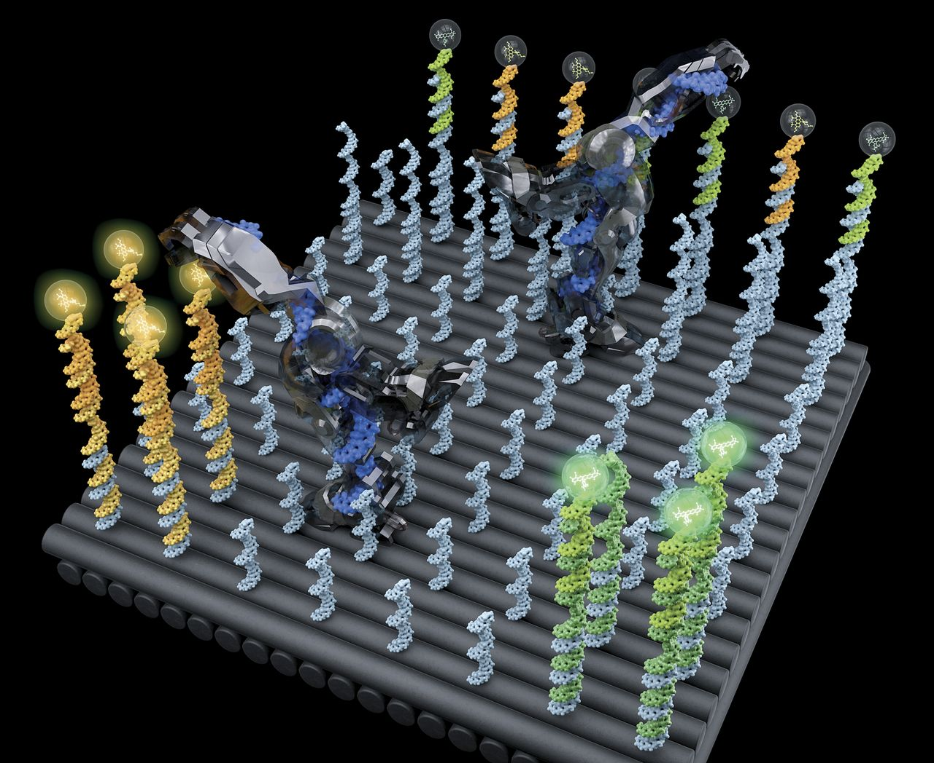
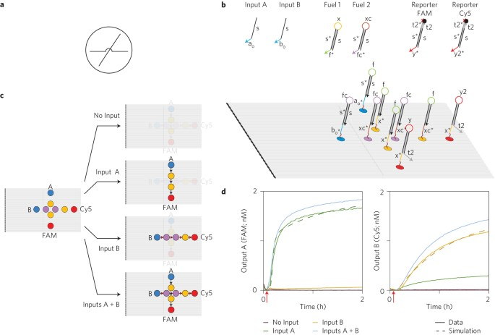
Motivation
A. J. Thubagere, W. Li, R. F. Johnson, Z. Chen, S. Doroudi, Y. L. Lee, G. Izatt, S. Wittman, N. Srinivas, D. Woods, et al. A cargo-sorting DNA robot. Science, 357(6356):eaan6558, 2017.
G. Chatterjee, N. Dalchau, R. A. Muscat, A. Phillips, and G. Seelig. A spatially localized architecture for fast and modular DNA computing. Nature nanotechnology, 12(9):920–927, 2017.

Slide 19
Previous work/Contributions

Slide 20
Results
Linear Surfaces
Grid Surfaces
General Surfaces

Slide 21
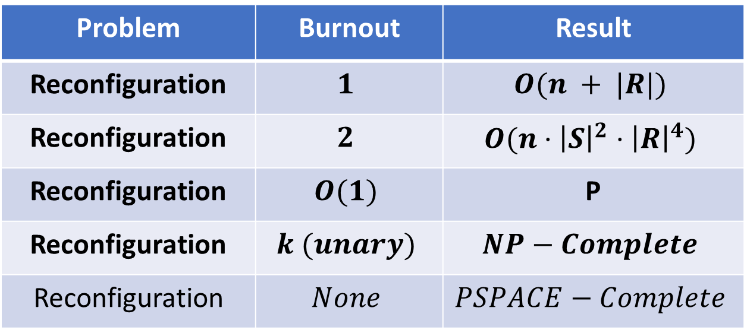
Linear Surfaces
Problem | Burnout | Result
Reconfiguration | $$1$$ | $$O(n + |R|)$$
Reconfiguration | $$2$$ | $$O(n⋅{\left|S\right|}^{2}⋅{\left|R\right|}^{4})$$
Reconfiguration | $$O(1)$$ | P
Reconfiguration | $$k (unary)$$ | $$NP−Complete$$
Reconfiguration | $$None$$ | $$PSPACE−Complete$$

Slide 22




1-burnout
$$…$$
Configuration I
Configuration D
$$s$$
$$t$$

Slide 23
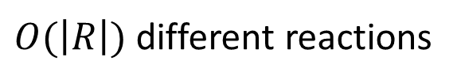
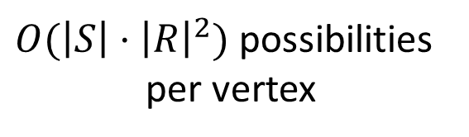

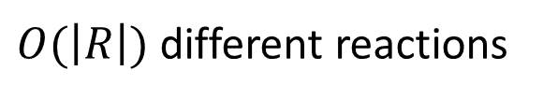
2-burnout
$$…$$
Configuration I
Configuration D
Initial:
$O(\left|R\right|)$ different reactions
Intermediate:
$$⇒$$
$O(\left|S\right|⋅{\left|R\right|}^{2})$ possibilities
per vertex
$O(\left|R\right|)$ different reactions
Target:
Result: $O(n⋅\left|S\right|⋅{\left|R\right|}^{2})$ cells and $O(\left|S\right|⋅{\left|R\right|}^{2})$ runtime per cell $=O(n⋅{\left|S\right|}^{2}⋅{\left|R\right|}^{4})$ runtime

Slide 24
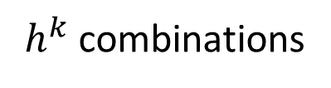
O(1)-burnout
$$…$$
Configuration I
Configuration D
$h^{k}$ combinations

Slide 25

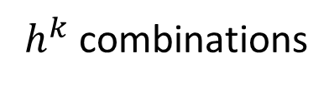
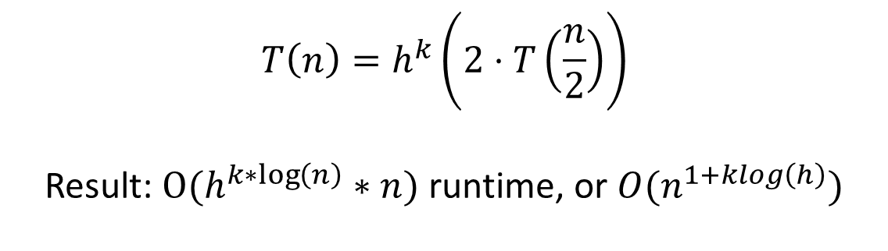
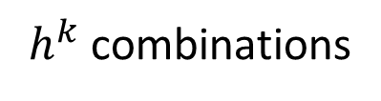
O(1)-burnout
$$…$$
Configuration I
Configuration D
$h^{k}$ combinations
$$T\left(n\right)=h^{k}\left(2⋅T\left(\frac{n}{2}\right)\right)$$
Result: $O(h^{k∗\log\left(n\right)}∗n)$ runtime, or $O(n^{1+klog\left(h\right)})$
$$⇒$$
$h^{k}$ combinations
$h^{k}$ combinations

Slide 26






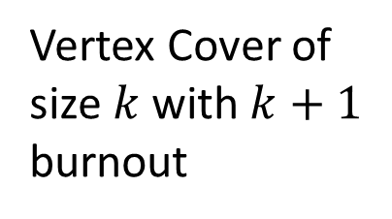

K-burnout
$$BS_{0}−12−13−14−24 −E$$
Vertex Cover:
$$BS_{0}−1^{′}x−1^{′}x−1^{′}x−x4^{′}−E$$
1
$$B−xx−xx−xx−{x4^{′}−S}_{1}^{1}E$$
Vertex Cover of size $k$ with $k+1$ burnout
3
$$⇒$$
$$⇒$$
$$B−xx−xx−xx−x4^{′}−S_{1}E$$
2
$$BS_{2}^{4}−xx−xx−xx−xx−E$$
4
$$BS_{2}−xx−xx−xx−xx−E$$

Slide 27
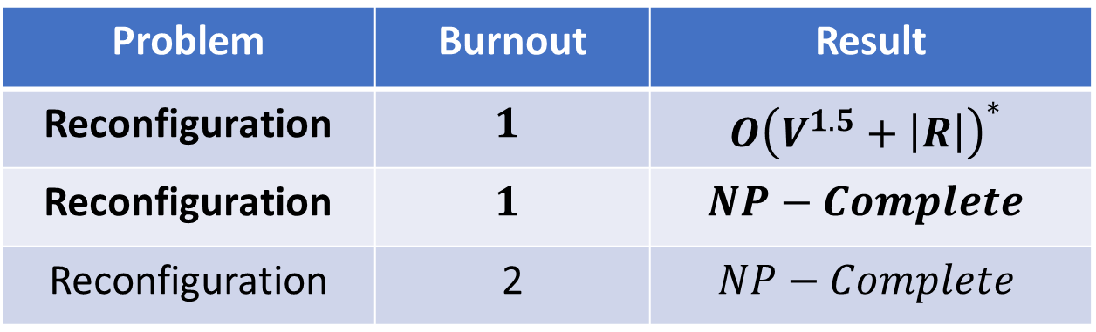
General Surfaces
Problem | Burnout | Result
Reconfiguration | $$1$$ | $$O{\left(V^{1.5}+\left|R\right|\right)}^{∗}$$
Reconfiguration | $$1$$ | $$NP−Complete$$
Reconfiguration | 2 | $$NP−Complete$$
* Non-catalytic reactions

Slide 28


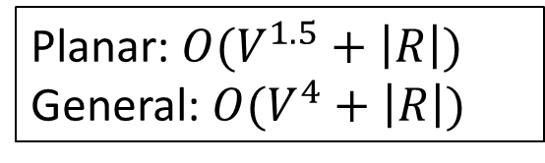

1-burnout (Non-catalytic rules only)
Species:
Rule:
$$⇒$$
$$⇒$$
$$→$$
Configuration I
Configuration D
Planar: $O(V^{1.5}+\left|R\right|)$
General: $O(V^{4}+\left|R\right|)$

Slide 29
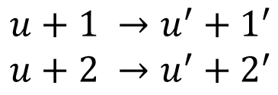

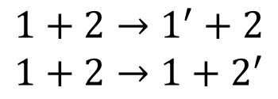

1-burnout (No restriction on rules)
Dominating Set:
2
3
1
3
1
$$u$$
4
3
$$⇒$$
2
$$1+2→1^{′}+2$$
$$1+2→1+2^{′}$$
$$u+1 →u^{′}+1^{′}$$
$$u+2 →u^{′}+2^{′}$$
4

Slide 30

1-burnout (No restriction on rules)
Dominating Set:
2
3
1
3
1
$$u$$
4
3
$$⇒$$
2’
1’
3’
2
4
$$u′$$
4’

Slide 31
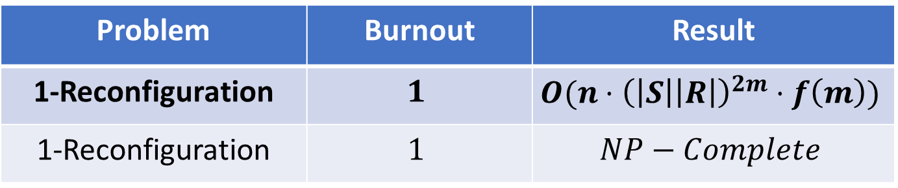
Grid Surfaces
Problem | Burnout | Result
1-Reconfiguration | $$1$$ | $$O(n⋅{\left(\left|S\right|\left|R\right|\right)}^{2m}⋅f\left(m\right))$$
1-Reconfiguration | $$1$$ | $$NP−Complete$$

Slide 32
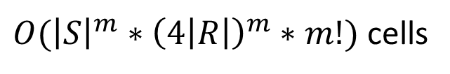



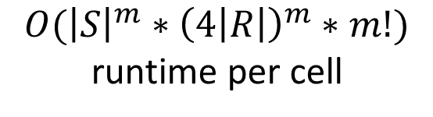
1-burnout (1-reconfiguration)
$$⇒$$
$$⇒$$
$O({\left|S\right|}^{m}∗{\left(4\left|R\right|\right)}^{m}∗m!)$ runtime per cell
$O({\left|S\right|}^{m}∗{\left(4\left|R\right|\right)}^{m}∗m!)$ cells
Result: $O\left(n⋅{\left(\left|S\right|\left|R\right|\right)}^{2m}⋅f\left(m\right)\right)$

Slide 33
Conclusion

Slide 34
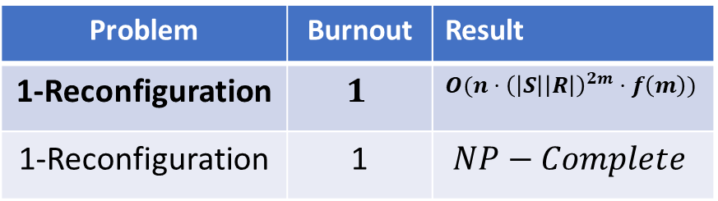
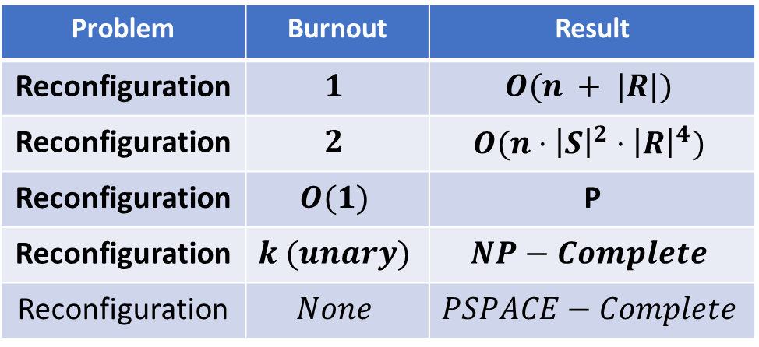
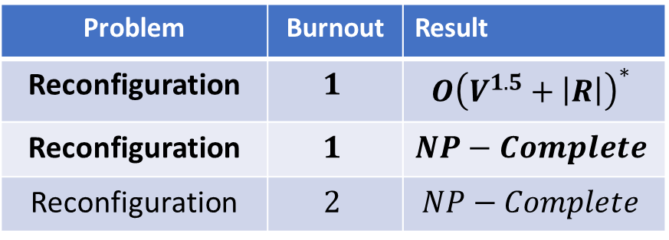
Known + New Results
General Surfaces
Problem | Burnout | Result
Reconfiguration | $$1$$ | $$O{\left(V^{1.5}+\left|R\right|\right)}^{∗}$$
Reconfiguration | $$1$$ | $$NP−Complete$$
Reconfiguration | $$2$$ | $$NP−Complete$$
Linear Surfaces
Planar and General Surfaces
Planar and General Surfaces
Problem | Burnout | Result
Reconfiguration | $$1$$ | $$O(n + |R|)$$
Reconfiguration | $$2$$ | $$O(n⋅{\left|S\right|}^{2}⋅{\left|R\right|}^{4})$$
Reconfiguration | $$O(1)$$ | P
Reconfiguration | $$k (unary)$$ | $$NP−Complete$$
Reconfiguration | $$None$$ | $$PSPACE−Complete$$
* Non-catalytic reactions
Grid Surfaces
Problem | Burnout | Result
1-Reconfiguration | $$1$$ | $$O(n⋅{\left(\left|S\right|\left|R\right|\right)}^{2m}⋅f\left(m\right))$$
1-Reconfiguration | 1 | $$NP−Complete$$

Slide 35
Open Problems
Lower bounds for k-burnout on linear surfaces
Other than size of surface, what about:
  Species, rules and burnout
Any FPT algorithms for reconfiguration

Slide 36
Known + New Results
General Surfaces
Problem | Burnout | Result
Reconfiguration | $$1$$ | $$O{\left(V^{1.5}+\left|R\right|\right)}^{∗}$$
Reconfiguration | $$1$$ | $$NP−Complete$$
Reconfiguration | $$2$$ | $$NP−Complete$$
Linear Surfaces
Planar and General Surfaces
Planar and General Surfaces
Problem | Burnout | Result
Reconfiguration | $$1$$ | $$O(n + |R|)$$
Reconfiguration | $$2$$ | $$O(n⋅{\left|S\right|}^{2}⋅{\left|R\right|}^{4})$$
Reconfiguration | $$O(1)$$ | P
Reconfiguration | $$k (unary)$$ | $$NP−Complete$$
Reconfiguration | $$None$$ | $$PSPACE−Complete$$
* Non-catalytic reactions
Grid Surfaces
Problem | Burnout | Result
1-Reconfiguration | $$1$$ | $$O(n⋅{\left(\left|S\right|\left|R\right|\right)}^{2m}⋅f\left(m\right))$$
1-Reconfiguration | 1 | $$NP−Complete$$

